Slide 1
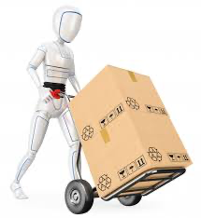
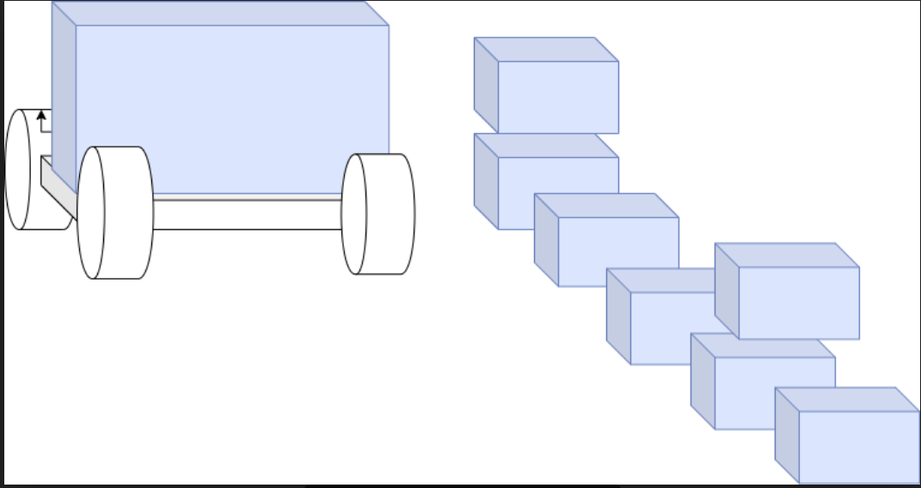
ROBONOX
By Sarkari

Slide 2
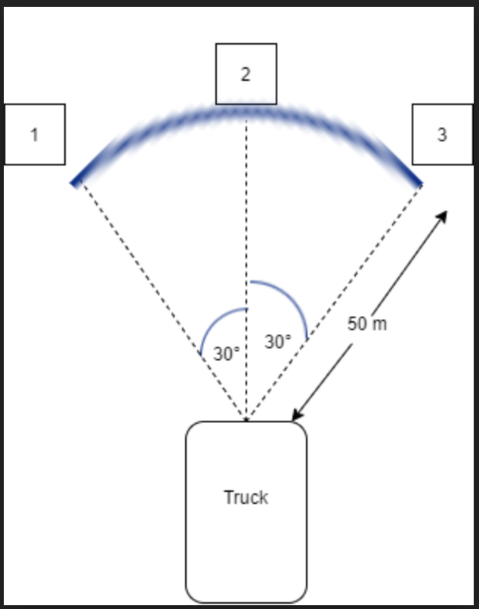
PROBLEM STATEMENT
Courier deliveries is essential part of today’s world. It’s high need can be felt in the current pandemic situation, as well. It is difficult to continue the efficient service of parcel deliveries amidst the COVID-19 outbreak, when social distancing is necessary.
So how do we cater people all over the world with stable deliveries without affecting the efficiency of our service?
This bot is the answer to all our problems.
Our robots function to unload the packages from the truck and segregate it according to the pincode. (look at the adjacent
This will not only reduce the man labour but also help us achieve proper social distancing.

Slide 3
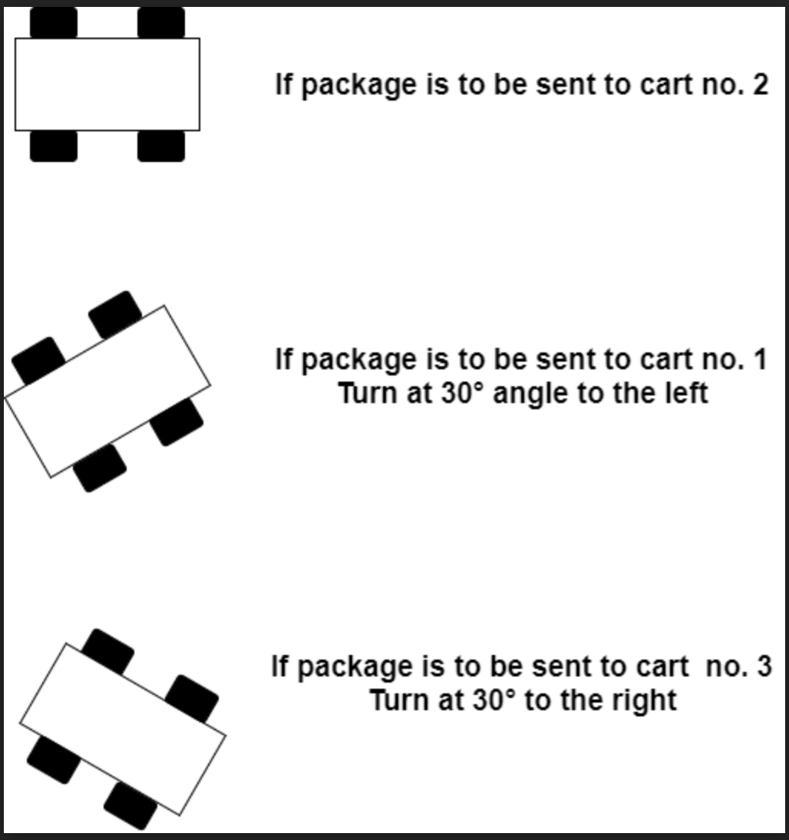
IDEA
The parcel / package will be unloaded from the truck by a bot which will keep it on our moving cart bot.
The parcel will be placed at unloading point(truck) by the user on our bot. It will be kept on a quad-rotating platform to scan the barcode on any one of 4-sides of the parcel. The parcel is rotated to scan the barcode. Then barcode is scanned using a RPi.
After scanning the parcel the bot will move towards its destination according the scanned pincode (see the adjacent figure for the movement implementation).
Servo motor is being used to set the angle of rotation of the bot. Then the bot moves on a straight path for 50m and comes back for next parcel delivery.

Slide 4
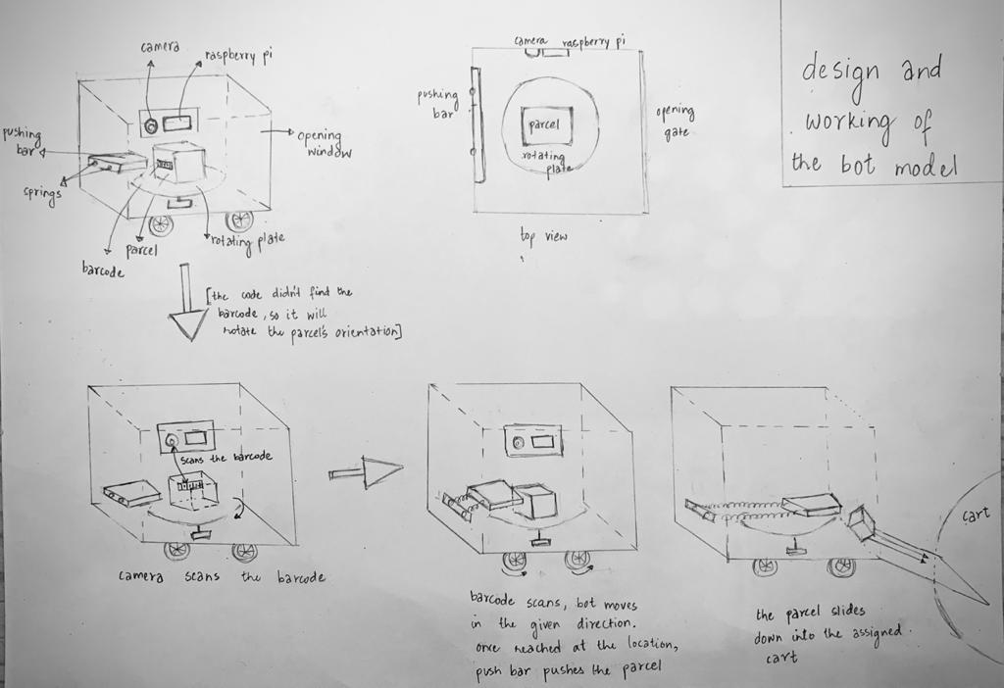
DESIGN AND WORKING OF THE MOVING BOT MODEL

Slide 5
WORKING MECHANISM
The bot picks up a parcel from the truck using mechanical design and then puts inside the bot at the center above a rotating surface.
The Rotator rotates the package and then we will process the video frames from cam using raspberry pi. After grabbing the frame from a threaded video stream, we decode the barcode and check the assigned pin code that matches with three given pincodes. If Pincode matches with given pincodes then it gives signal through Raspberry Pi to Arduino. Then finds the barcode in the frame.
If no barcode is found on the surface then the rotator on bottom rotates it. Servo is used here again for the rotation purpose of parcels.
After getting the location to be delivered the bot turns accordingly and moves straight for 50m.
On reaching the final delivery point, the linear actuator connected to a bar will gently push the parcel out of the bot.
The bot moves backward 50m to the initial point.

Slide 6
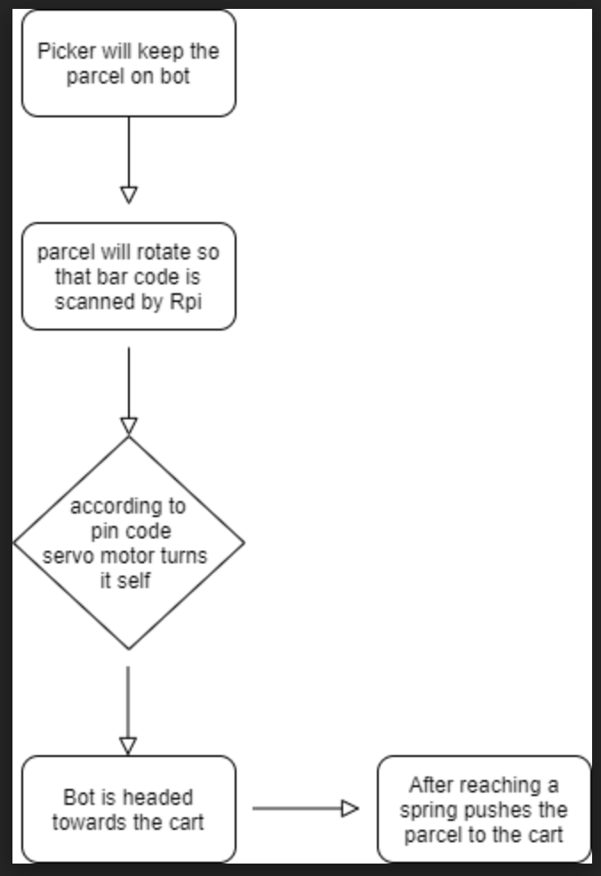
FLOW CHART

Slide 7
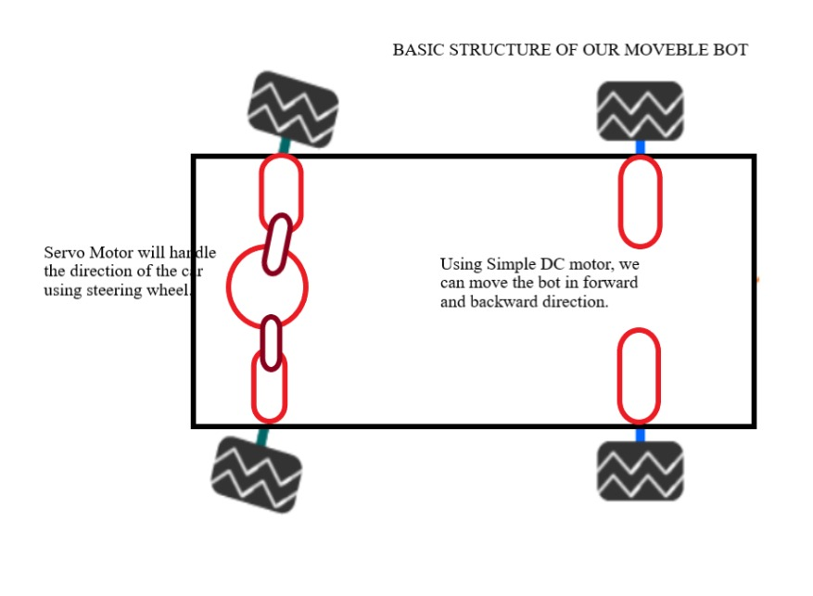
BASIC STRUCTURE OF THE MOVEMENT BELT

Slide 8
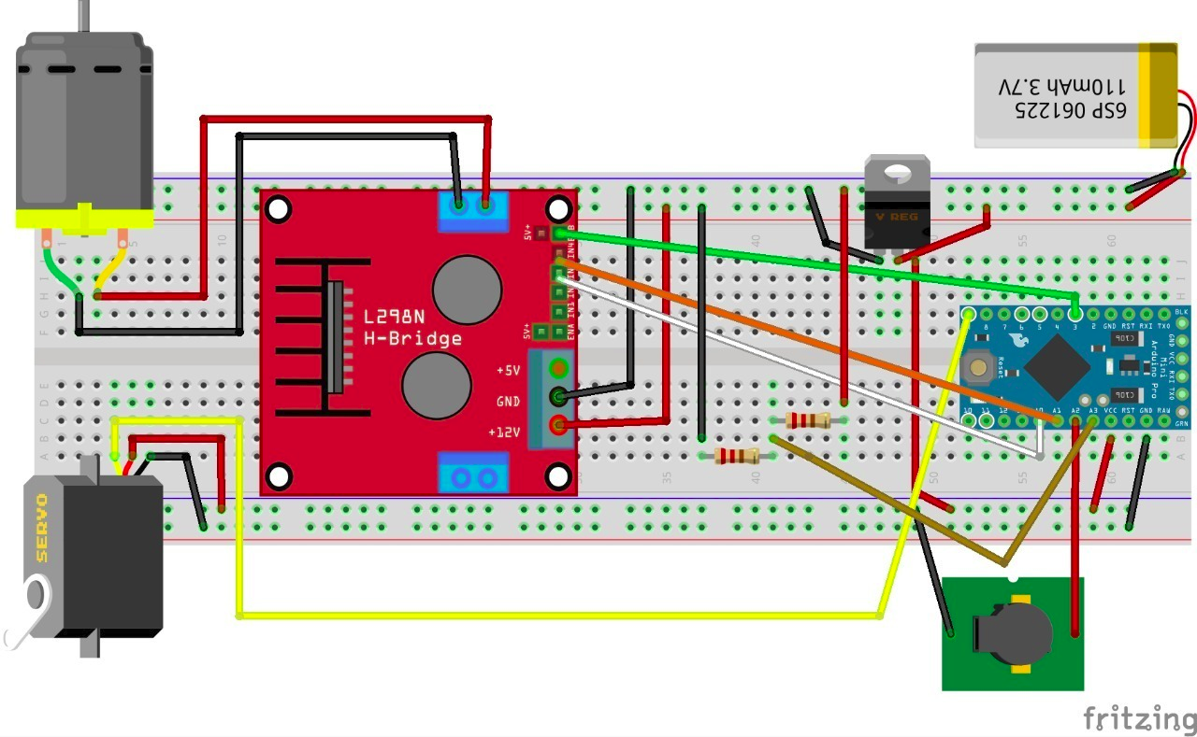
Main circuit connecting various modules used in a bot

Slide 9
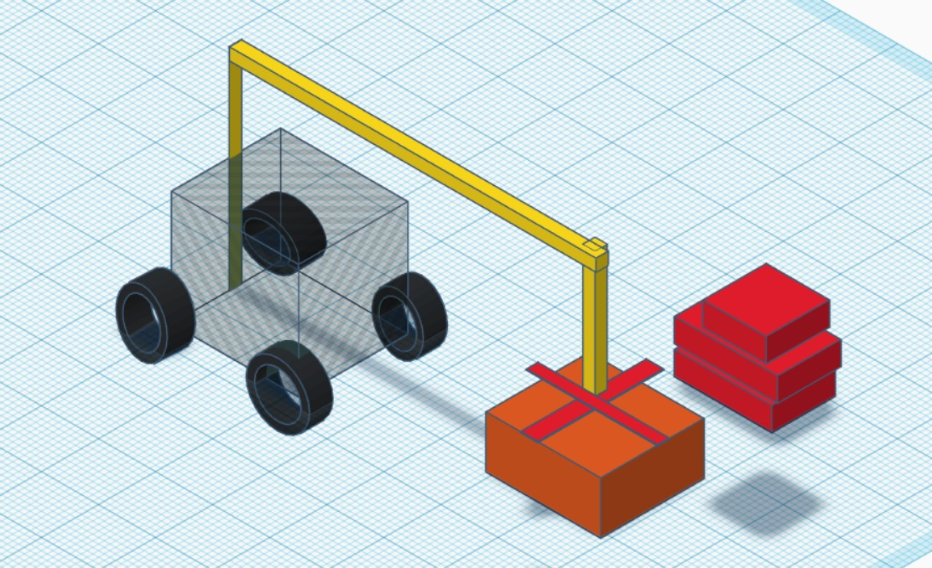
FOR PICKING UP PARCELS FROM TRUCK.

Slide 10
THANK YOU !

